Slide 1

Voneus Broadband
is coming to Lamyatt

Slide 2
Who is Voneus?
Voneus is the champion of rural community broadband and a leading provider of Superfast and Gigabit enabled broadband for homes and businesses located in poorly connected, difficult to reach, or overlooked areas of the UK.
Founded in 2015, our broadband services are now live in over 26 counties.
We work closely with local communities, councils, local Broadband Action Groups and local ‘Broadband Champions’ to find the best way to engage and build relationships in the areas we work in.
In every community that we connect, we aim to give a free connection to a community hub.
Our service is backed up with round-the-clock support from Voneus’ team of experienced broadband technicians, engineers and customer support professionals.
We are an Associate Member of the British Holiday and Home Parks Association (BH&HPA), and our CEO sits on the boards of ISPA and WISPA.

Slide 3

Our funding partners

Slide 4
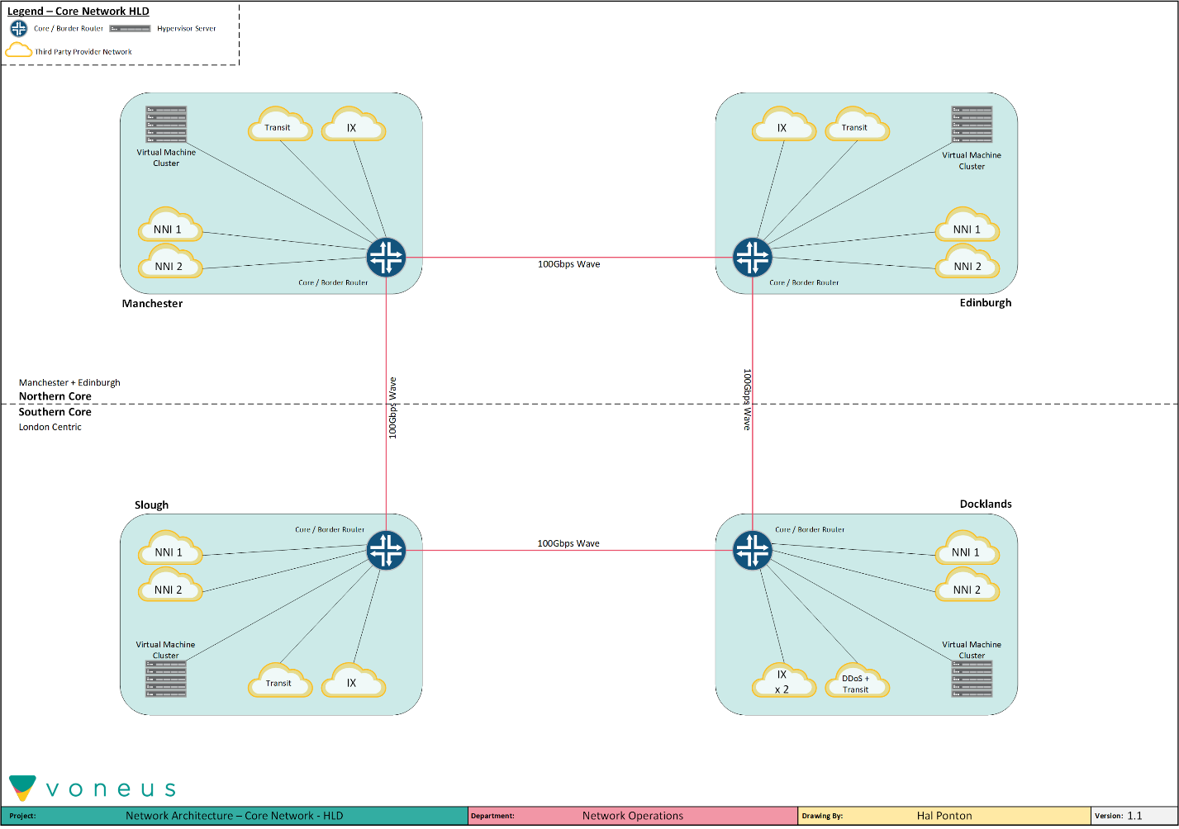
Voneus multi-region resilient 100Gbps core network

Slide 5
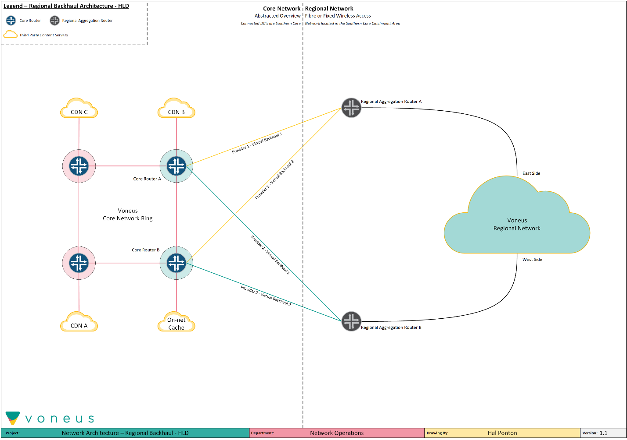
Voneus resilient access network design

Slide 6
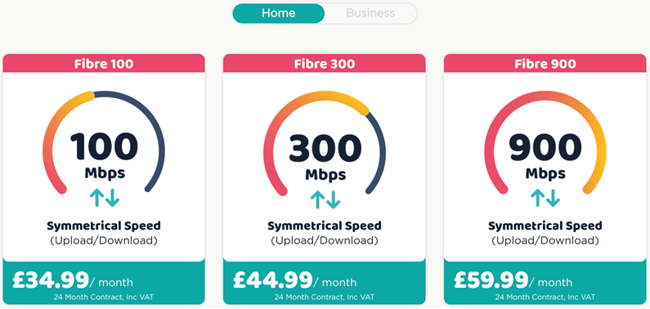
Speeds and packages
Our pricing is very simple and we don’t increase the price during the length of the contract!

Slide 7
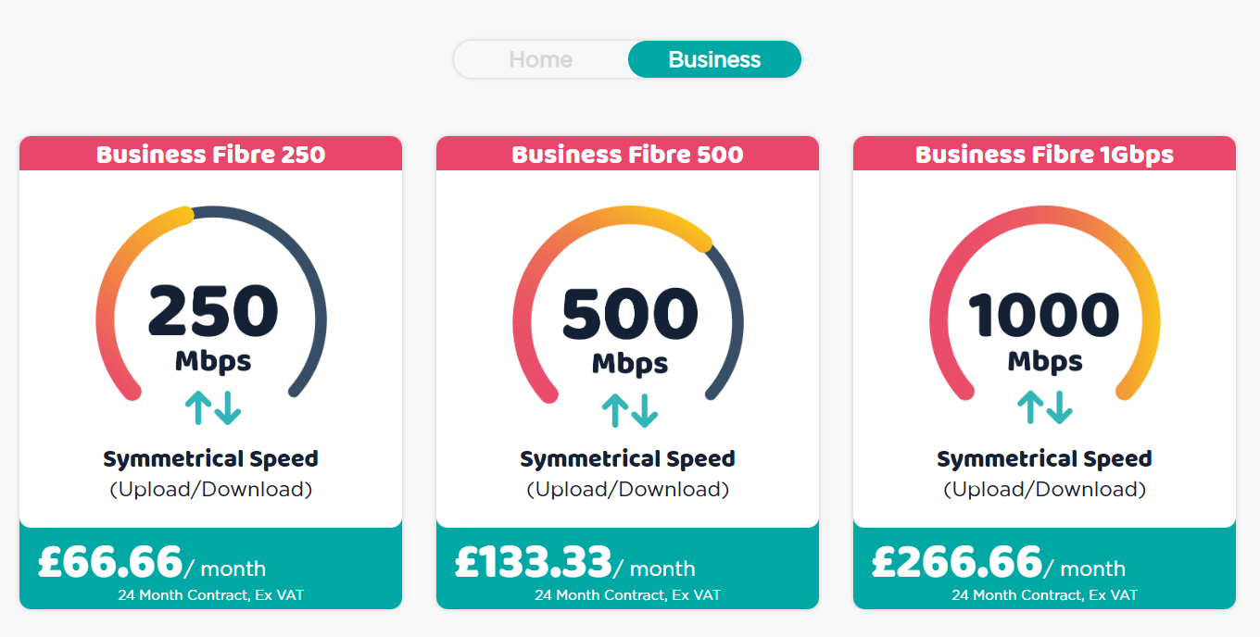
Speeds and packages
Our pricing is very simple and we don’t increase the price during the length of the contract!

